Slide 1
Speech EmotionRecognition
P.JOSIKA
2019202020
MCA-R
GUIDE:MS.R.L.JASMINE

Slide 2
ABOUT
This Project attempts to recognize human emotions based on the
voice as we are aware that voice and tone is an important feature to
detect the emotion.
It uses machine learning and deep learning algorithms which uses
CNN which is a type of artificial neural network which is widely used
for image/object recognition.

Slide 3
ADVANTAGES
Call Centre to predict customer emotions
Marketing to buy products
Telemedicine to know the condition of patients which helps in treating
To know the emotion of candidate in the interview

Slide 4
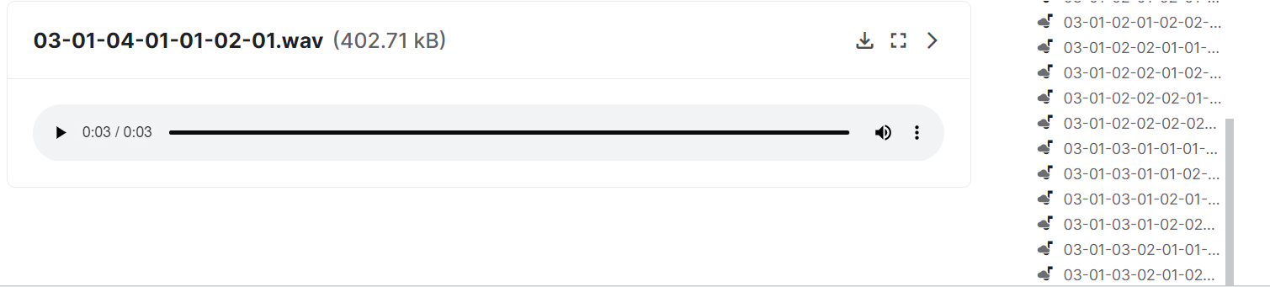
DATA SETS
This project uses four kinds of data sets
RAVDESS

Slide 5
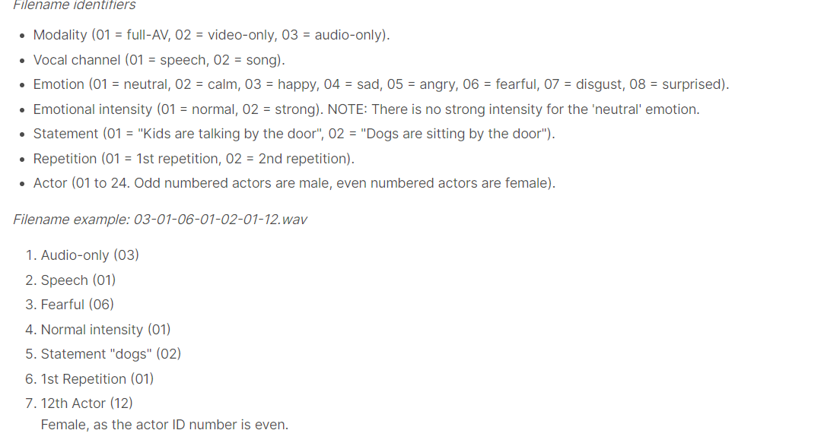

Slide 6
9 EMOTIONS
Neutral
Calm
Happy
Sad
Angry
Fear
Disgust
Pleasant
Surprise
Boredom

Slide 7
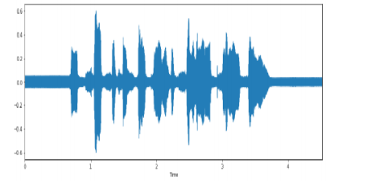
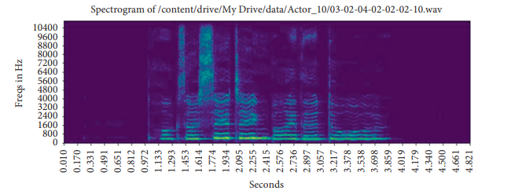
Wave form and Spectogram

Slide 8
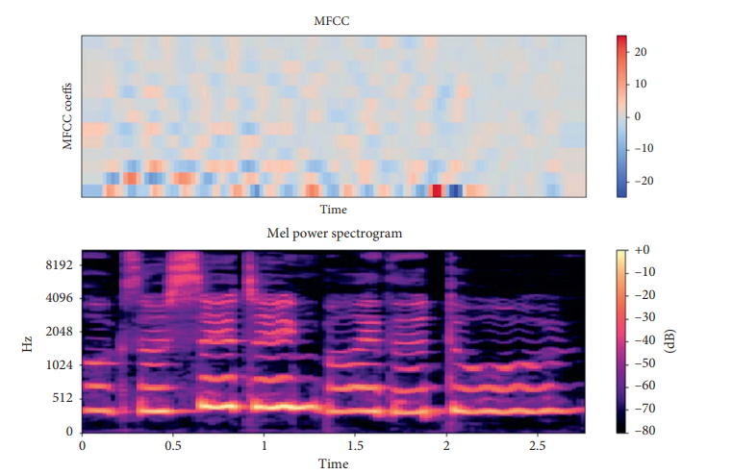
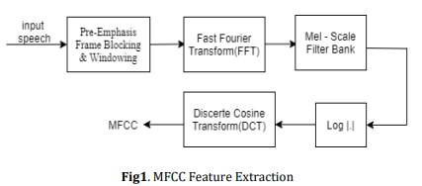
MFCC

Slide 9
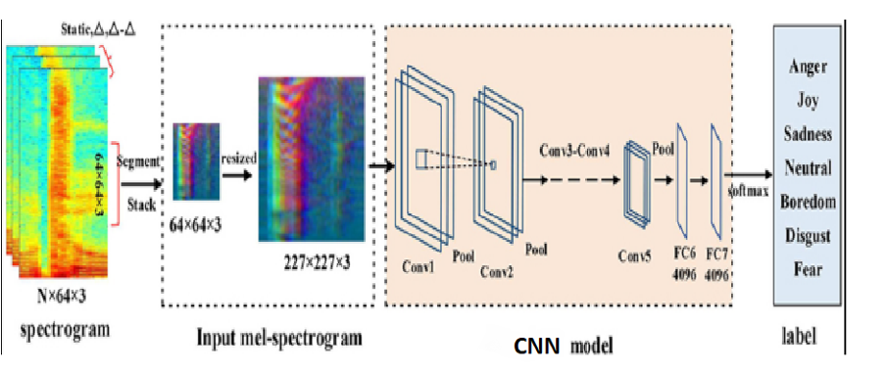
CNN

Slide 10
TECHNOLOGIES
Tools – PyCharm
Language – Python3
Libraries – Librosa, Keras,Soundfile,Tqdm
Model-CNN
Comparing classification algorithms like SVM,KNN,Logistic
Regression

Slide 11
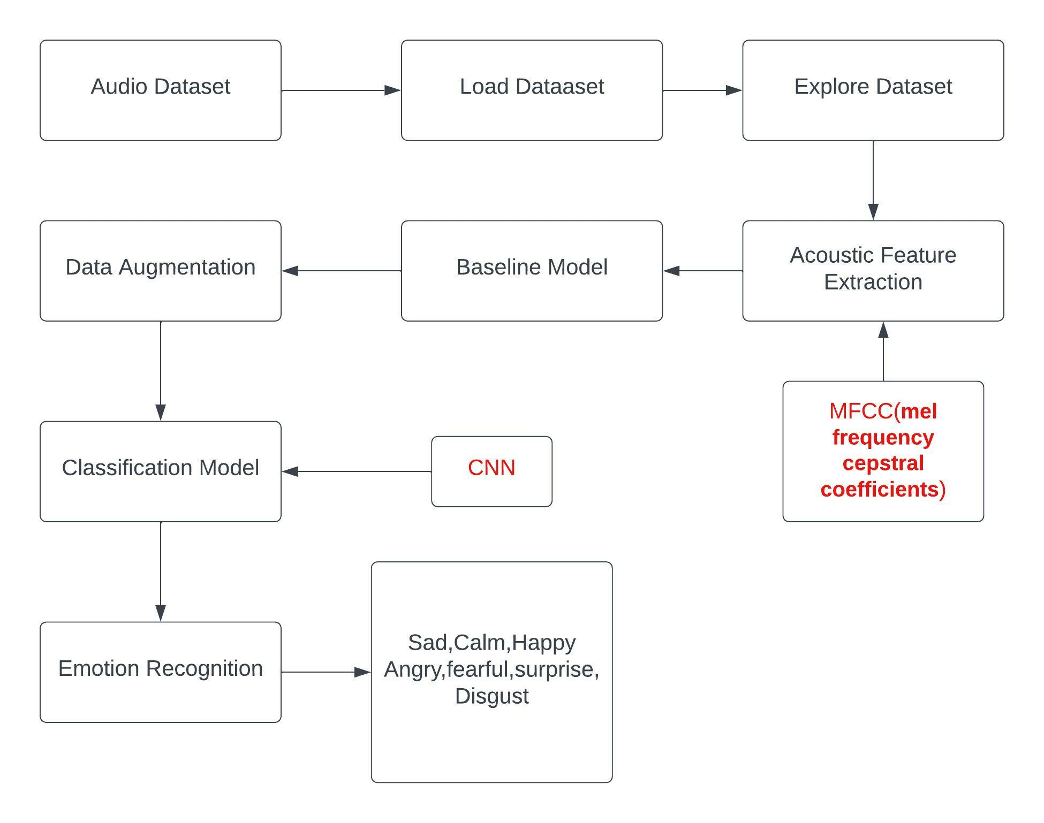
ARCHITECTURE DIAGRAM

Slide 12
REFERENCES
[1] El Ayadi, M., Kamel, M.S. and Karray, F., 2011. Survey on speech
emotion recognition: Features, classification schemes, and databases.
Pattern Recognition, 44(3), pp.572-587.
[2] Trigeorgis, G., Ringeval, F., Brueckner, R., Marchi, E., Nicolaou, M.A.
and Zafeiriou, S., 2016, March. Adieu features? End-to-end speech
emotion recognition using a deep convolutional recurrent network. In
2016 IEEE International Conference on Acoustics, Speech and Signal
Processing (ICASSP) (pp. 5200-5204). IEEE.
[3] LeCun, Y., Bengio, Y. and Hinton, G., 2015. Deep learning. Nature,
521(7553), pp.436-444.
[4] Chakraborty, R. and Kopparapu, S.K., 2016, July. Improved speech
emotion recognition using error correcting codes. In Multimedia & Expo
Workshops (ICMEW), 2016 IEEE International Conference .

